Slide 1

John Rice & Erik van Zwet’s Paper
“A Simple and Effective Method for
Predicting Travel Times on Freeways“
Author Le Xu

Slide 2
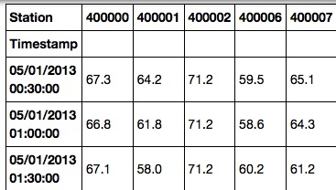
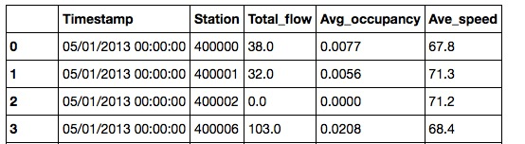

data/Data preprocessing
Interstate 880 is an Interstate Highway in the San Francisco Bay Area connecting San Jose and Oakland. Length: 45.7 mi
From total 697824 sensors to 2423 single-loop sensors
Find out distance between two consecutive sensors
Calculate Space Mean Speed

Slide 3

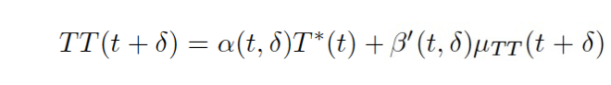
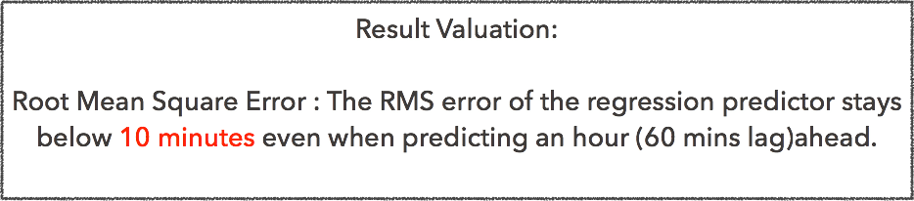
Original Linear model from the paper
Predicting Future Travel Time for 60 mins time lag
Express a future travel time as a linear combination of the historical mean and current status travel time

Slide 4

New Linear model
Predicting Future Travel Time for 60 mins time lag
Express a future travel time as a linear combination of the historical mean and current status travel time
60 and 30
and Travel time from Previous hours
Gaussian Process Predicting model
Gaussian processes (GPs) are an approach for supervised learning (both regression and classification) with dependent data.
They can also be extended to many other tasks such as causal inference, long-range time series forecasting, and change detection.

Slide 5
Comments:
Both 60 mins lag and 30 mins lag have RMSE less than 5 mins.
But:
The MSE is too huge (Reached 20 many times)

Slide 6
Gaussian Process inference model
(60 mins lag, 95% Confidence intervel)

Slide 7
Gaussian Process Inference model
(30 mins lag, 95% Confidence intervel)

Slide 8


cONCLUSION:
Result Valuation From Paper:
Root Mean Square Error : The RMS error of the regression predictor stays below 10 minutes even when predicting an hour (60 mins lag) ahead.
Mean Square Error: This can always run up to 20 mins
Result Valuation From Us:
Root Mean Square Error : The RMS error of the regression predictor stays below 5 minutes even when predicting both 60 mins lag and 30 mins lag.
Instead of just using current status travel time and mean travel time, taking consideration of past few hours, such as the travel time for 2 hours before, and 5 hours ago. This method is able to keep MSE reduce to less than 10 minutes, compared to the 20 minutes level from the paper.

Slide 9
Predicting with Past 2 Hours
MSE within 5 mins
Predicting with Past 5 Hours
MSE within 10 mins

Slide 10
“Thank You”

